Slide 1

St John the Baptist RC Primary School
One Family in Christ
Headteacher: Mrs L. Campbell
Newsletter 16th October 2026
We have our #proud superstars this week who have shown great improvement in their handwriting:
Isio
Dua
Arwa
Layla
Maira
Marlous
Kobi
Aisha P
Our Y1 phonics star is Qasim!
Well done everyone – keep working hard
One Family in Christ.
☺ Mrs Campbell
Head-teacher awards | Qualities of the class ‘woman of the Bible’ | Celebration of Talent spotting
Nursery (Jochabed) | Alyza | Harvey Amen
Reception (Miriam) | Zahra | Yasa
Y1 (Elizabeth) | Deborah | Shiloh Mustafa
Y2 (Prisca) | Solomon-Blessing | Niyar Omari
Y3 (Sheba) | Joseph | Manahil Tiana
Y4 (Deborah) | Yasmin | Hussain Roman
Y5 (Esther) | Leandro | Perfect Zainab
Y6 (Lydia) | Naafay | Esmee Yusuf
Class | Reception | Y1 | Y2 | Y3 | Y4 | Y5 | Y6
Attendance: week beg 12/10/26 | 88.3 | 97.5 | 96 | 93.3 | 97.1 | 94.8 | 98.4
Visit our website for more information: https://www.stjohnthebaptist.stoccat.org.uk
01706 647 195

Slide 2
St John the Baptist RC Primary School
One Family in Christ
Headteacher: Mrs L. Campbell
Catholic Life
Gospel: Matthew 22:1-14
Jesus again used parables in talking to the people. “The Kingdom of heaven is like this. Once there was a king who prepared a wedding feast for his son. He sent his servants to tell the invited guests to come to the feast, but they did not want to come. So he sent other servants with this message for the guests: ‘My feast is ready now; my bullocks and prize calves have been butchered, and everything is ready. Come to the wedding feast!’ But the invited guests paid no attention and went about their business: one went to his farm, another to his shop, while others grabbed the servants, beat them, and killed them. The king was very angry; so he sent his soldiers, who killed those murderers and burnt down their city. Then he called his servants and said to them, ‘My wedding feast is ready, but the people I invited did not deserve it. Now go to the main streets and invite to the feast as many people as you find.’ So the servants went out into the streets and gathered all the people they could find, good and bad alike; and the wedding hall was filled with people.
“The king went in to look at the guests and saw a man who was not wearing wedding clothes. ‘Friend, how did you get in here without wedding clothes?’ the king asked him. But the man said nothing. Then the king told the servants, ‘Tie him up hand and foot, and throw him outside in the dark. There he will cry and grind his teeth.’”
And Jesus concluded, “Many are invited, but few are chosen.”
God asks us to be kind, to be welcoming and invite others to share in what we have, to bring peace, to stand up for what is right, to care for and respect one another and to love our neighbour, wherever they are in the world.​
Love of learning and playing together. One community, aiming high, helping each other and praying together. On our journey with Christ.
Visit our website for more information: https://www.stjohnthebaptist.stoccat.org.uk
01706 647 195

Slide 3
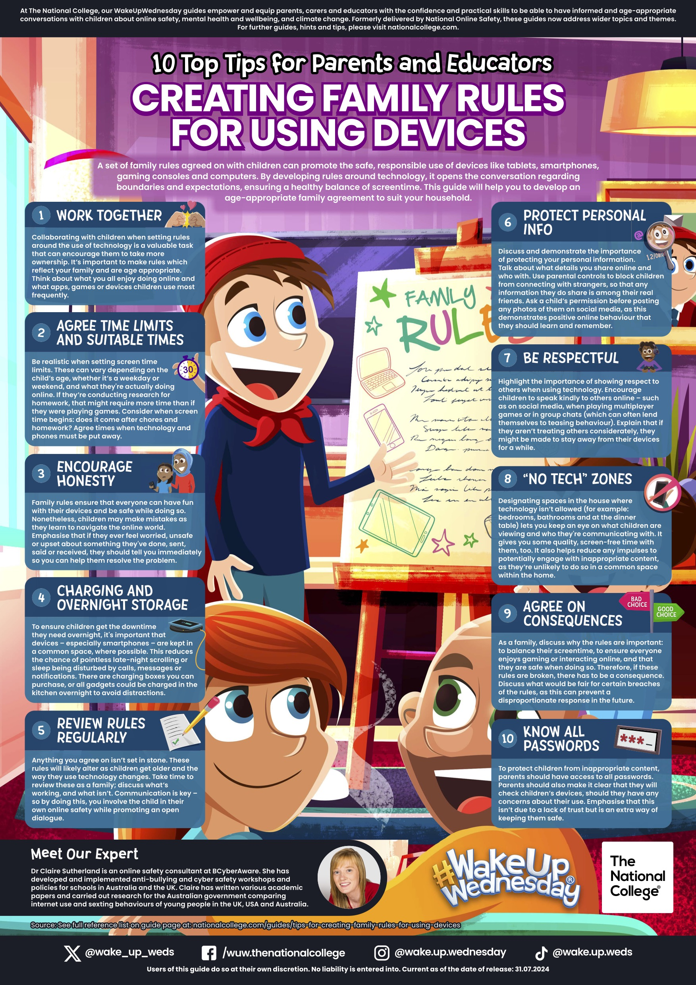
St John the Baptist RC Primary School
One Family in Christ
Headteacher: Mrs L. Campbell
Parent support: Using devices
We are “One family in Christ”
Visit our website for more information: https://www.stjohnthebaptist.stoccat.org.uk
01706 647 195

Slide 4
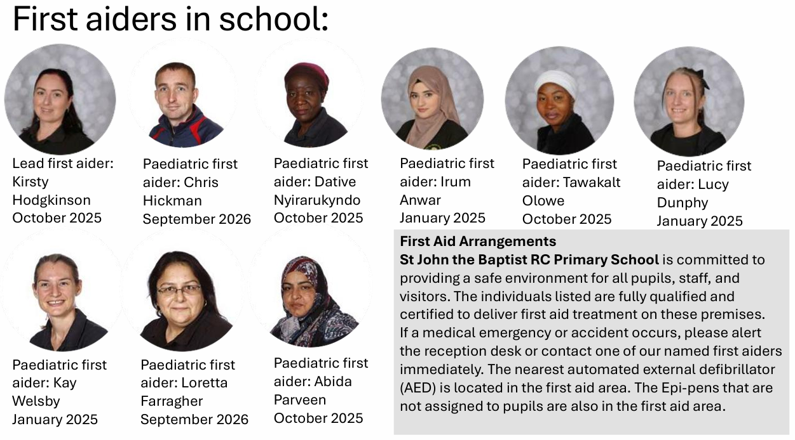
St John the Baptist RC Primary School
One Family in Christ
Headteacher: Mrs L. Campbell
Safeguarding
Safeguarding Our Children
This week, I am sharing our paediatric first aiders in school with you. The safety and wellbeing of every child is our highest priority, and having trained first aiders available is an important part of how we keep children safe throughout the school day. Training is renewed every three years and staff have additional training for specific conditions, such as asthma, allergies, diabetes and epilepsy.
Our staff work hard to ensure that children are cared for promptly and appropriately should they become unwell or have an accident. Safeguarding is everyone’s responsibility, and we are committed to providing a safe, caring environment where every child feels protected, valued and able to thrive. Thank you for continuing to work in partnership with us to keep our children safe.
Every child with a medical condition has an individual healthcare plan and our Allergen policy is available on our website
18.-HS18-School-Allergen-Management-Policy.pdf
We are “One family in Christ”
Visit our website for more information: https://www.stjohnthebaptist.stoccat.org.uk
01706 647 195

Slide 5

St John the Baptist RC Primary School
One Family in Christ
Headteacher: Mrs L. Campbell
Support for parents
We are “One family in Christ”
Visit our website for more information: https://www.stjohnthebaptist.stoccat.org.uk
01706 647 195

Slide 6
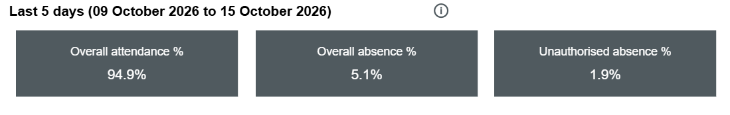
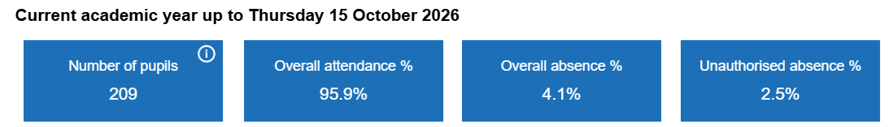
St John the Baptist RC Primary School
One Family in Christ
Headteacher: Mrs L. Campbell
The importance of Attendance
Our attendance this week is 94.9%
Please ensure absence is reported by calling the office before 9am on 01706 647195.
Our attendance this year so far is 95.9%.
Polite reminder:
Term time trips cannot be authorised
Please book routine appointments after school time
Attendance meetings and plans will be put in place to support children being in school. We, like you, want the children to achieve their very best.
We are “One family in Christ”
Visit our website for more information: https://www.stjohnthebaptist.stoccat.org.uk
01706 647 195

Slide 7
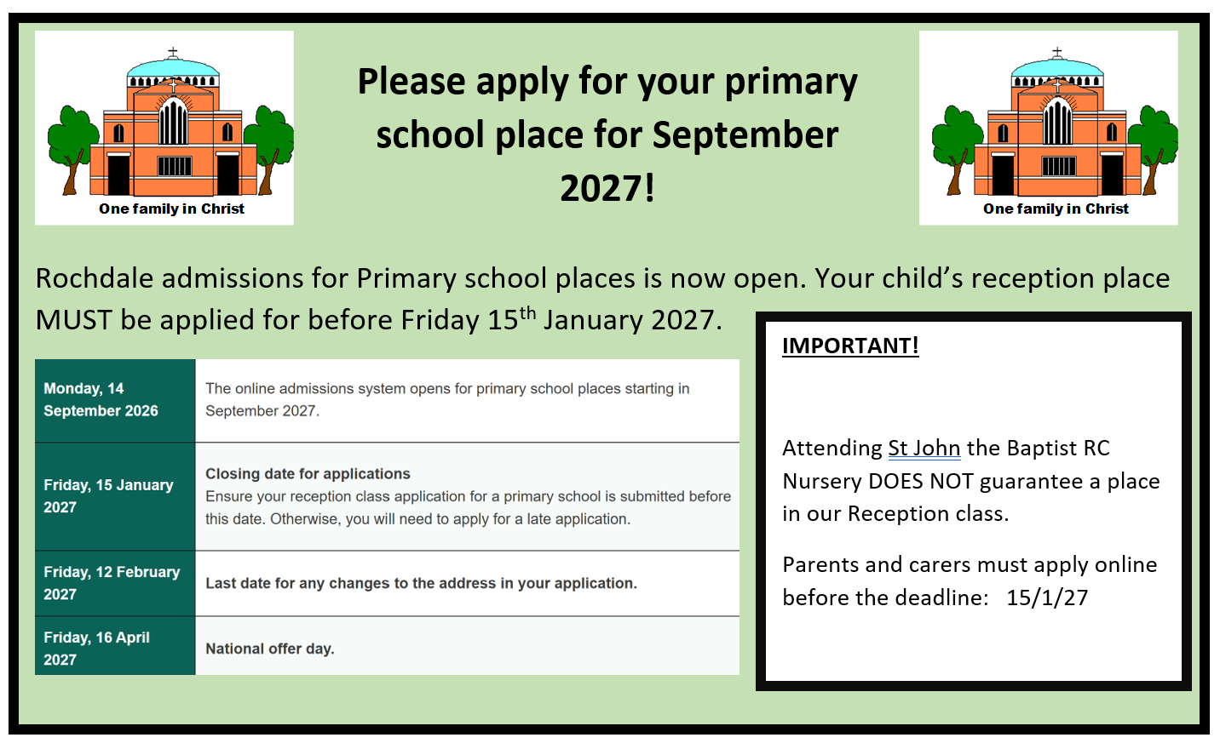
St John the Baptist RC Primary School
One Family in Christ
Headteacher: Mrs L. Campbell
Reception 2027 Applications
The portal for Reception places (2027 start) is now open: https://www.rochdale.gov.uk/school-admissions-appeals/apply-primary-school-place/4
https://startingreception.co.uk/
We are “One family in Christ”
Visit our website for more information: https://www.stjohnthebaptist.stoccat.org.uk
01706 647 195

Slide 8
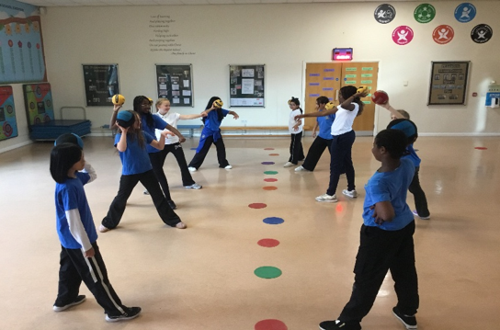
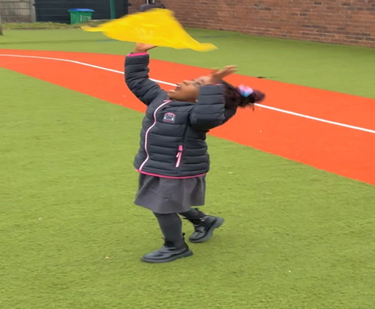
St John the Baptist RC Primary School
One Family in Christ
Headteacher: Mrs L. Campbell
Year 6 Intra Dodgeball
Last Thursday the girls in year 6 participated in an intra dodgeball event. The teams were picked and managed by themselves as well as creating one new rule which they had to follow in the last match.
Nursery Physical Development
This week in PD we were focussing on our hand eye
Coordination. We used scarves to throw with one hand and catch with the other. Using a scarf helps the children because it drops slower and gives them a longer reaction time.
We are “One family in Christ”
Visit our website for more information: https://www.stjohnthebaptist.stoccat.org.uk
01706 647 195

Slide 9
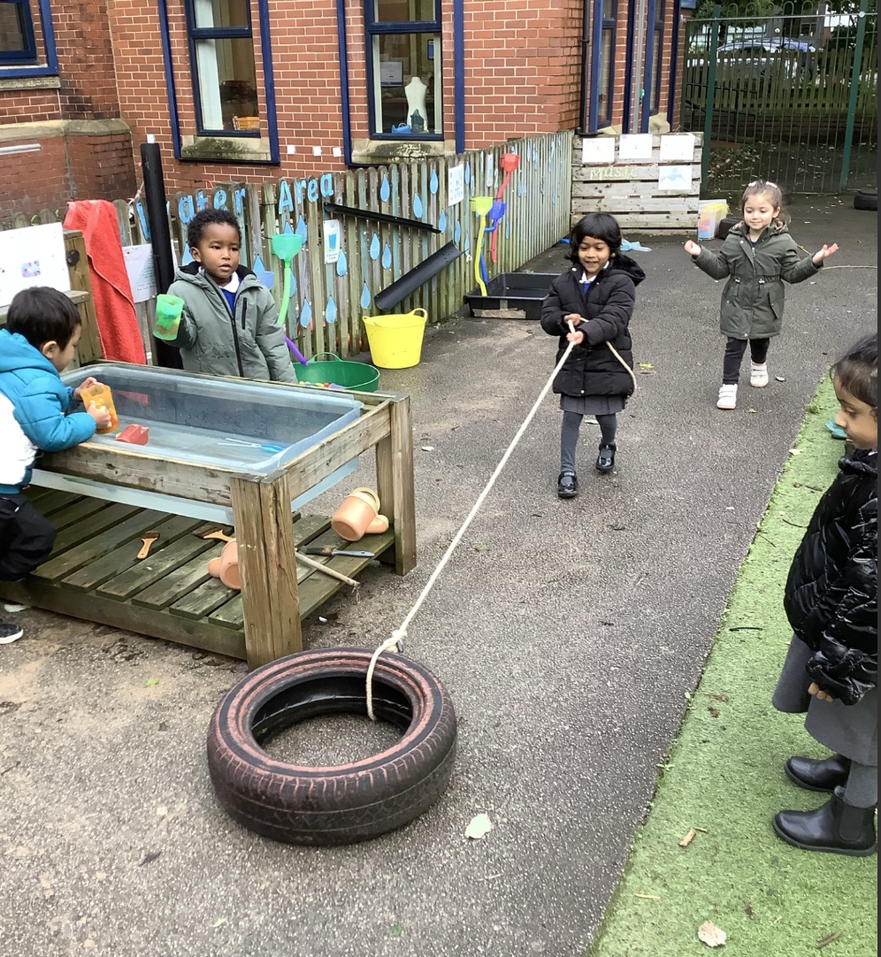
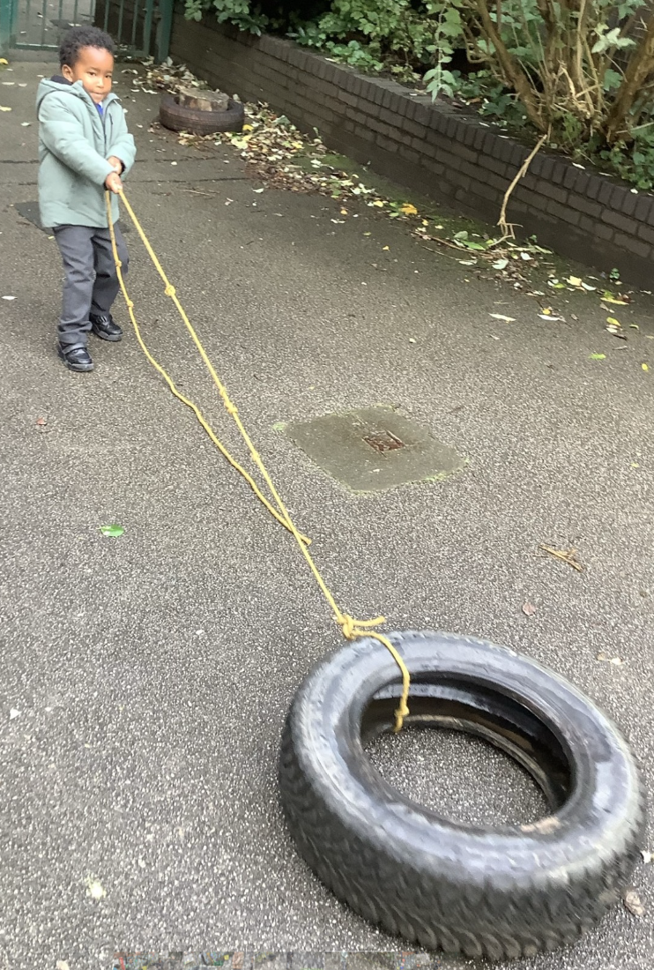
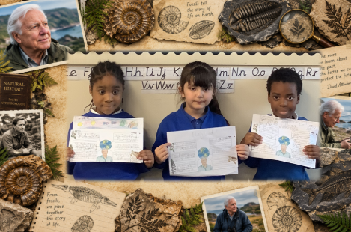
St John the Baptist RC Primary School
One Family in Christ
Headteacher: Mrs L. Campbell
Early Years Foundation Stage and Key Stage 1
Year 1 have had a fantastic term exploring why David Attenborough is a hero and they created a poster this week to showcase their learning.
The Nursery children have been developing their strong foundations this week. We have been working on strengthening our gross motor skills by pulling the tyres around the outdoor area. The children tried and tested different positions and methods to see which made it easier to move the tyres.
“Love one another as I have loved you.” John 15:12
Visit our website for more information: https://www.stjohnthebaptist.stoccat.org.uk
01706 647 195

Slide 10
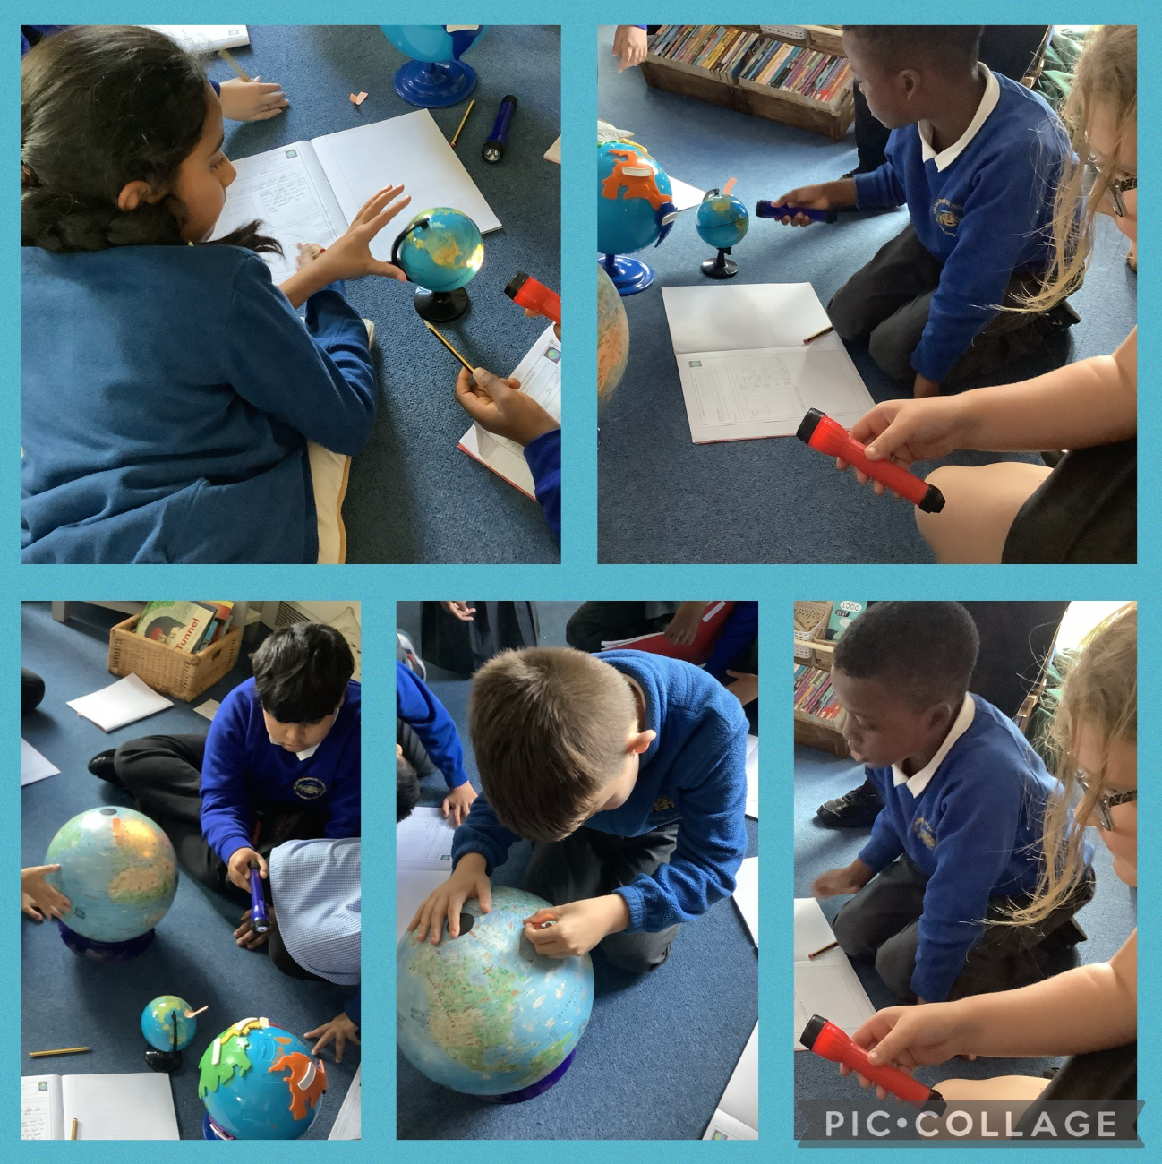
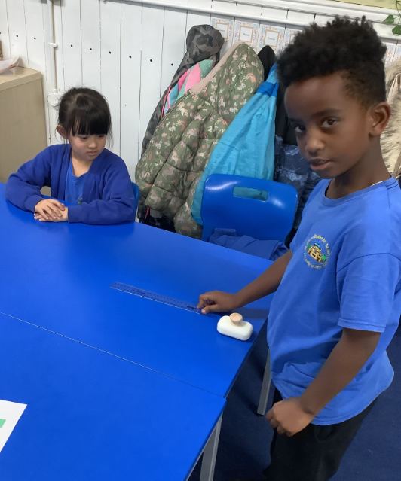
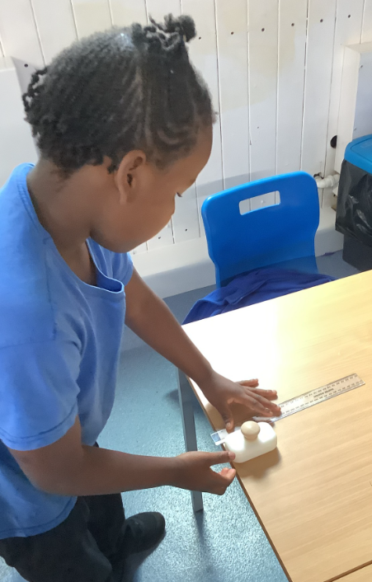
St John the Baptist RC Primary School
One Family in Christ
Headteacher: Mrs L. Campbell
KS2
In Year 3, we did an experiment on friction forces, using soap and water and measured the distance the soap travelled in a dry and wet condition.
Year 5 have been investigating why we experience day and night as part of our Earth and Space topic. Using a torch to represent the Sun and a globe to represent the Earth, the children explored how the Earth's rotation causes different parts of the world to experience daylight and darkness. They developed their scientific enquiry skills by making predictions, observing changes and recording their findings!
Love of learning and playing together. One community, aiming high, helping each other and praying together. On our journey with Christ.
Visit our website for more information: https://www.stjohnthebaptist.stoccat.org.uk
01706 647 195

